Slide 1
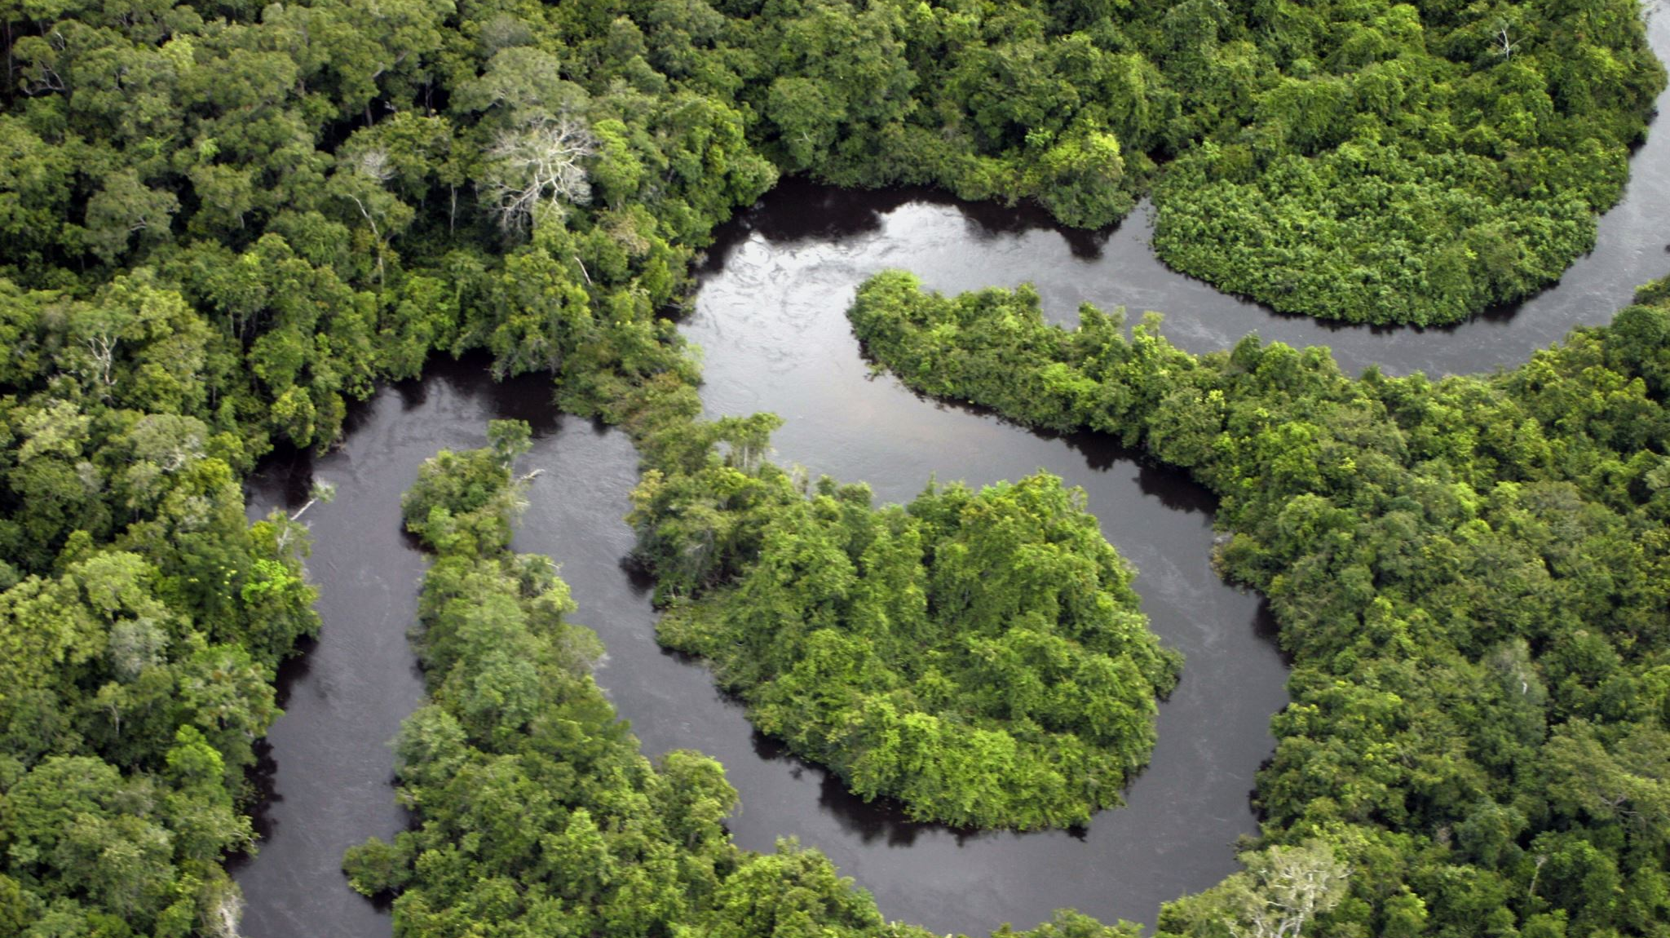
Optimizing Bioeconomy Logistics For The Amazon Region
Progress meeting: 03/06/2024
Group 6: Mamoun, Chenlu, Abdul, Mai, Mia, Bhumin

Slide 2
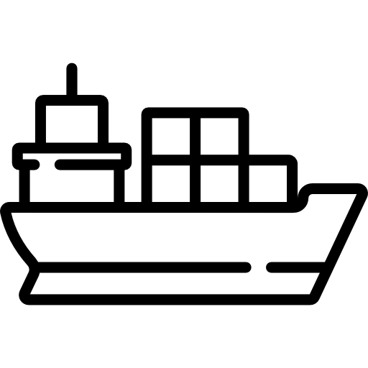





Overview
Transport and Broader Challenges
Modelling and Data Processing
Key Stakeholders
2
4
6
1
3
5
Progress
Potential Transportation Strategies
Potential Conflicts Between Stakeholders
2

Slide 3
Progress
Deliverables
1. Outline of key stakeholders and assessments of their interests and influences
2. Identification of potential conflicts between stakeholders
3. List of transport and broader challenges tied to current transport infrastructure
4. List of potential transportation strategies
Data Gathering and Processing
Mia
Mamoun
Abdul
Bhumin
Chenlu
Mai
All Memebers

Slide 4








Key Stakeholders
Local Communities
Local Authorities
Local Organizations
National Government
Private Companies
Banks
Customers
Environmental NGOs

Slide 5
Key Stakeholders
 | High Influence | Low influence
High Interest | National Government Local Authority Private Companies | Indigenous people and local Communities Local organisations/ Associations/ Cooperatives NGOs
Low Interest | Banks | Customers

Slide 6
Potential Conflict between Stakeholders
Acai
 | Indigenous/Local | Local Auth | Local Orgs | Nat Gov | Private Co. | Banks | Customers | NGOs | Dams | Water Transport
Indigenous/Local
Local Auth
Local Orgs
Nat Gov
Private Co.
Banks
Customers
NGOs
Dams
Water Transport
No conflict: No mention of conflict or clear harmony.
Low conflict: Minor disagreements or potential for conflict.
Medium conflict: Clear and ongoing disagreements that affect operations but can be managed.
High conflict: Major, disruptive conflicts that significantly affect operations.

Slide 7
Potential Conflict between Stakeholders
Acai | Brazil Nut | Piracuru
Local Authorities vs National Government: Local authorities may have different priorities or regulations than national standards, leading to policy conflicts. |  | Private Companies vs Local Authorities: Conflicts may arise over compliance with environmental regulations versus the companies’ logistical and operational needs.
Local Authorities vs Indigenous People: might implement regulations that do not align with the traditional practices of indigenous communities. National Government vs Indigenous People: Conflict arises when important decisions are made without asking local communities, those who live there can feel like they are not important. There should be a fair distribution of profits and members of this community must participate in any decision-making process. Private Companies vs Indigenous People: Private companies may prioritize efficiency and cost-reduction, possibly compromising sustainable practices important to local communities. Private Companies vs Local Organisations: Disagreements over logistics operations and profit sharing; companies may push for more control over the supply chain. Private companies may prioritize profit and efficiency, potentially leading to disagreements over fair pricing and sustainable practices. | National Government vs Indigenous People: Local communities may have traditional methods and needs that conflict with broader national policies or innovation initiatives. National Government vs Local Organisation: The national government may impose policies that conflict with local cooperatives' operational strategies and autonomy. Private Companies vs Local Authorities: Conflicts over the control of logistics and storage technologies, with companies potentially pushing for practices that locals do not support. Private Companies vs NGO: Environmental NGOs may oppose the methods used by private companies if they are deemed harmful to the environment. | Private Companies vs Indigenous People: Communities may resist changes that threaten traditional practices or sustainability, while companies focus on profitability and efficiency National Government vs Indigenous People: Local communities may have traditional methods and needs that conflict with broader national policies or innovation initiatives. The national government may introduce fishing regulations that are not aligned with traditional fishing practices, leading to disputes. Local Organisations vs Local Authorities: Local governance may impose regulations that restrict the operational flexibility of local organizations, affecting their ability to manage resources efficiently

Slide 8
Potential Conflict between Stakeholders
Acai | Brazil Nut | Pirarucu
Local Authorities vs National Government: different priorities or regulations |  | Private Companies vs Local Authorities: Conflicts over compliance with environmental regulations
Local Authorities vs Indigenous People: regulations interrupt way of living National Government vs Indigenous People: important decisions are made without asking local communities, Private Companies vs Indigenous People: Private companies may compromise sustainable practices important to local communities. Private Companies vs Local Organisations: disagreements over fair pricing and sustainable practices. | National Government vs Indigenous People: broader national policies or innovation initiatives interrupt tradition National Government vs Local Organisation: policies conflicting with operational strategies and autonomy. Private Companies vs Local Authorities: Conflicts over the control of logistics and storage technologies Private Companies vs NGO: Push back for methods which deemed harmful to the environment | Private Companies vs Indigenous People: Communities may resist changes that threaten traditional practices, while companies focus on profitability and efficiency National Government vs Indigenous People: Fishing regulations that are not aligned with traditional fishing practices Local Organisations vs Local Authorities: regulations may restrict the operational flexibility of local organizations

Slide 9
Transport and Broader Challenges
Challenges |  | Road | Rail | Water | Air
Construction |  | Difficulties in construction and maintenance
 |  | High construction costs due to little infrastructure
 |  |  |  | Lock and dyke construction
 |  |  |  | Dredging and widening of river channels
Utilisation and Operation | Mode | Cost and effectiveness of the specialised design
 |  |  |  | Climate challenges
 |  |  | Current low network density affects transport efficiency
 |  |  | Balance between frequency and operating costs
 |  |  |  | Limited capacity and functionality
 | Facility |  | Lack of handling equipment and storage facilities at train stations
 |  |  |  | Port adaption and resilience
 | Technology | Lack of real-time information
 |  | Low map accuracy and precision
 |  |  |  | Insufficient navigation equipment
 | Personnel | Inexperienced drivers
 |  |  |  | Engagement of indigenous people
Laws and Regulations | Intra-region | Strict environment conservation requirements
 |  | Avoiding the destruction of Aboriginal communities
 |  |  |  | Security risks and regulations
 | Inter-region |  |  | Long customs clearance process deteriorates the quality of products

Slide 10
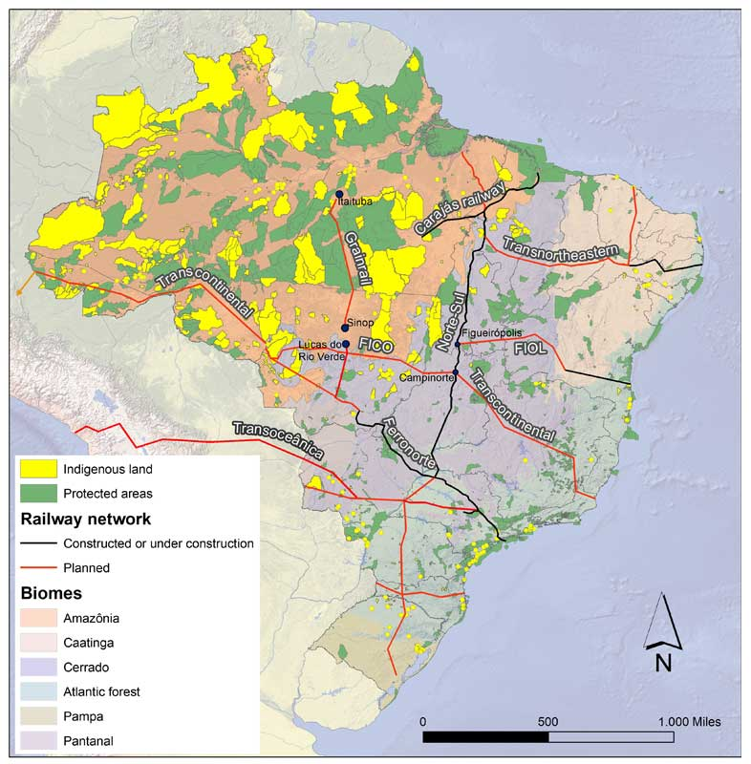
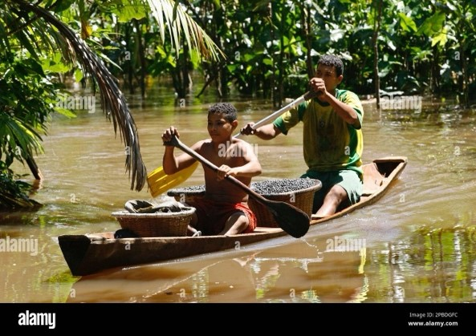
Transport and Broader Challenges
Acai berry collection canoes,
Alamy, 2007
A map of major proposed and existing Brazilian railways, Monabay, 2020

Slide 11
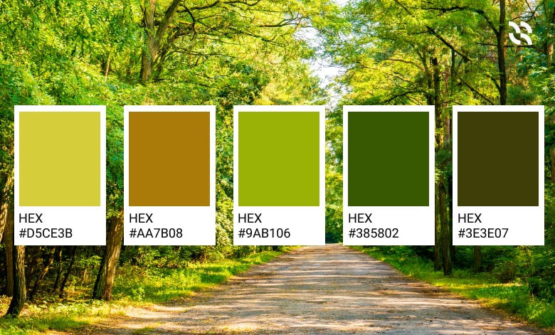




Transport Strategies - Methodology
Minimised Cost
Minimised Transit Time
Setting up initial structure:
5 Main strategic goals
15 Secondary strategic goals
3 Echelons
Critical features consideration
Multi-Criteria Decision Making (MCDM)
For iterative refinement
Based on literature supported relative
Importances
Minimised Environmental Impact
Minimised Initial Implementation Time
Maximised Local Benefits
Considerations
Modes | Existing
 | Potential
Inter-modal
Transport infrastructures | Existing
 | Potential
Organisational structure
Warehouse placements
Containment type
Infrastructure ownership
Loading process
Operation structure
Energy distribution | Type
 | Sources
 | Sources Location
Echelons
1
1
2
3
Notes:
Main points:
- First strategy iteration is based on 5 main goals
Each of which is constructed using 10 main considerations, specific for each echelon
The strategies will be rated using Multi-Criteria Decision Making method, expanding on successful aspect of the plan and discard underperformed part

Slide 12
Transport Strategies - Example
Strategic aim: Minimised Environmental Impact
Considerations |  | Echelons
 |  | 1 | 2 | 3
Modes | Existing | Canoes and dugout canoes (Pirogues) | Barges
 | Potential | Electrified motorised canoes, Amphibious boat | Electrified Cargo Rail
Inter-modal |  | Dry Port (reduce water pollution, does not disrupt the aquatic life, better emission regulation)
Transport infrastructures | Existing | Waterway | Waterway, Railway
 | Potential |  | Waterway segregation using policy to minimise area effected by transportation, more connected railway system to minimise first/last mile transportation)
Organisational structure |  | Government own (Could better regulate the emission and improve practice in safety and Eco friendliness)
Warehouse placements |  | Centralised warehouse (Reduce infrastructure footprint, better emission regulation, better resource utilisation)
Containment type |  | Break-bulk (The container could be made from locally sources biodegradable material, minimised the need for metalic container and its handling machinery)
Infrastructure ownership |  | Government own (Could better regulate the emission and improve practice in safety and Eco friendliness)
Loading process |  | RORO (minimise need for heavy energy intensive machinery, faster and quieter)
Operation structure |  | Bulk Cargo (Large scale shipment will minimise the number of trip, increase trip/energy efficiency)
Energy distribution | Type | Manual or electric or bio-fuel | High efficiency fossil fuel vessel or electric, utilisation of bio-fuel
 | Sources | Renewable (Potentially solar or hydroelectric) | Ideally renewable
 | Sources Location | Localised (Increase small scale transmission efficiency) | Large Scale (Reduce infrastructure footprint, could be located far from forest, and easier to regulate the emission standard)
Main Benefits and Reasoning | The forest and its biodiversity are crucial to be maintain, this strategy will minimise noise, and air pollution generated in the forest area.
Main Drawbacks | New technology and infrastructure will require large scale investment in money and time. A lot of training in technology adoption and environmental awareness need to be completed. Could be hard to gain local corporation.
Secondary aims achieved | Enhanced Supply Chain Transparency, Improved Resilience to Climate Change, Increased Use of Renewable Energy, Strengthened Community Engagement, Advanced Technological Integration, Boosted Biodiversity Conservation, Promotion of Sustainable Practices, Improved Infrastructure Development, Continuous Improvement and Innovation, Education and Training
Notes:
This is an example for one of the plan,
This plan is built around the main goal of minimising environmental impact
Each consideration is listed in detail, and each plan has their benefit and reasoning, drawbacks, secondary aims achieved
This was done for all 5 of the main goal, using MCDM the best strategy could be identify and iterate upon

Slide 13

Data Collection – Acai and Brazil Nuts
We used:
19 years of data
Total production and value in Brazil
Detailed town production
To get:
Selection of town in Amazon forest
Site production map
Production and value over years
Forecasted production

Slide 14
Data Processing – Acai and Brazil Nuts
Data from 2000 to 2022
Empty data between 2017 and 2019
Covid Impact
Acai scam in 2011

Slide 15
Data Processing – Acai and Brazil Nuts
Data from 2000 to 2022
Empty data between 2017 and 2019
Covid Impact

Slide 16
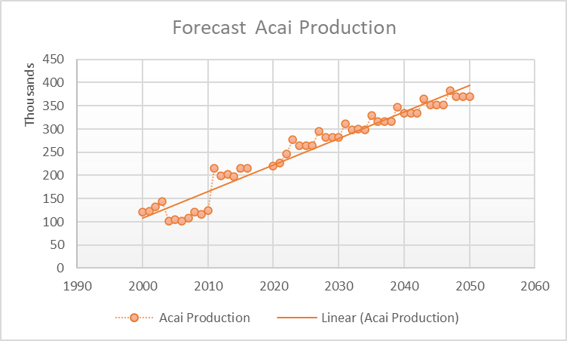
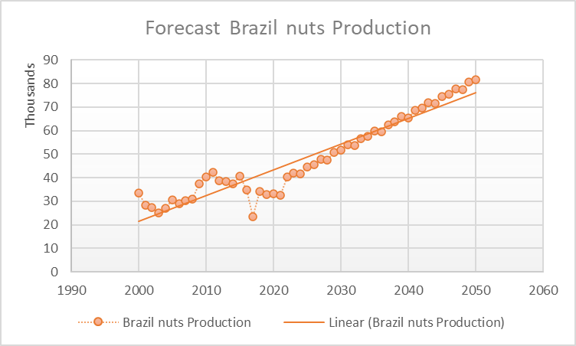
Production Forecast – Acai and Brazil Nuts
Holt winters forecast
Python code with Exponential smoothing
Trendline until 2050
Limitations

Slide 17
Production Forecast – Acai and Brazil Nuts
Holt winters forecast
Python code with Exponential smoothing
Trendline until 2050
Limitations

Slide 18
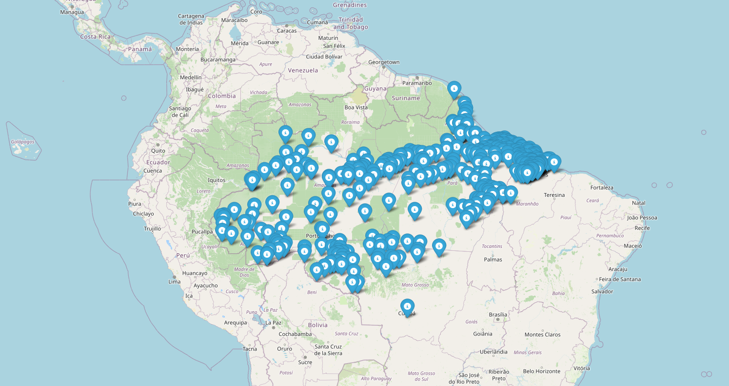
Production site – Acai and Brazil nuts
Production Forecast – Acai and Brazil Nuts
We used:
Latest Data for town Production (2016)
To:
Highlight each town that produce Acai or/and Brazil nuts (347 towns)
Select only the ones in Amazon forest
Plot them into a map
We get:
Town % in Brazil Amazon production
Forecast production of each town

Slide 19
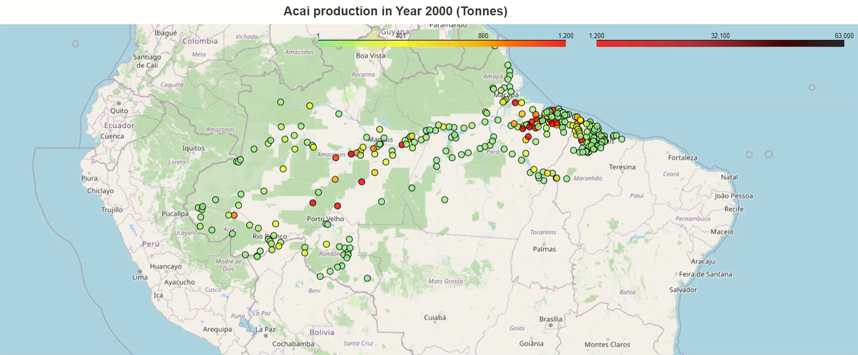
Acai Production and Distribution
Fluctuate in early 2000: Emerging trend against scams (US 2012) and lack of scientific report
Demand flatten from 2011 into the pandemic years
Demand starting to rise after lockdown
Main producers are well established
Notes:
After having the production amount, production location, and town production share: Acai historic and forecasted production distribution could be plotted
Play video (10seconds)
This allow us to see, the growth and distribution overtime, similar type of map could also be done for other country and products

Slide 20
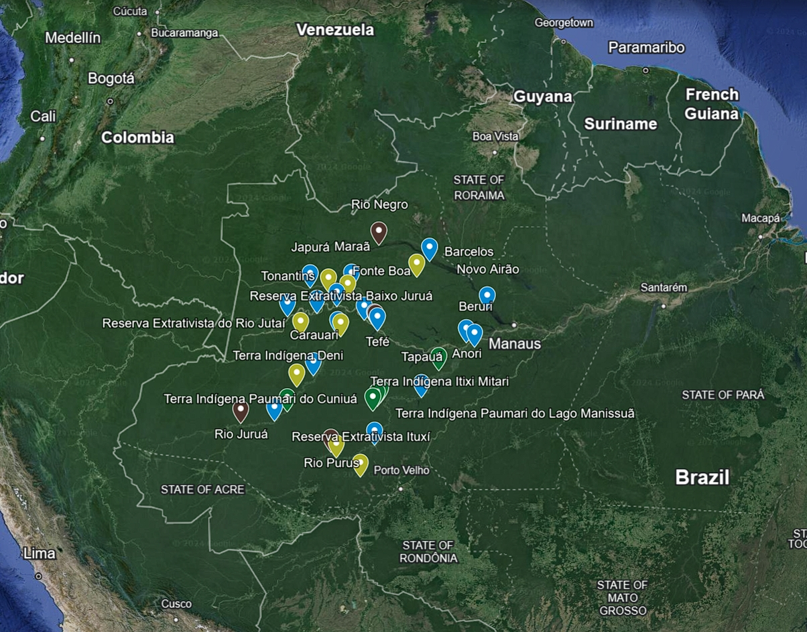
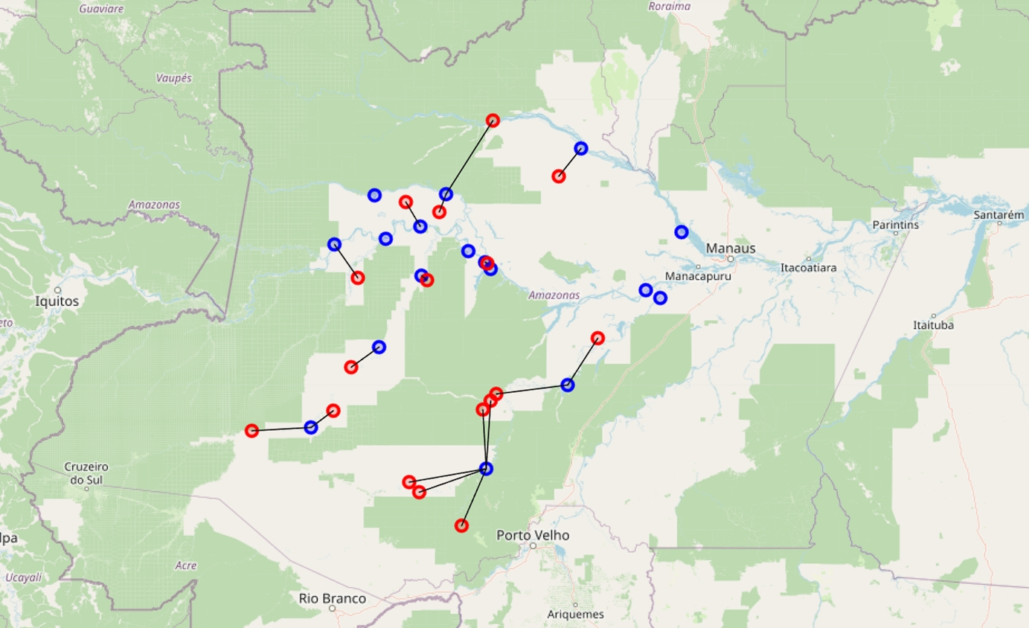
Data – Pirarucu
Fishing and storage sites in Pirarucu, Amazonas State, Brazil. Including development reserves, extractive reserves, town, and indigenous lands.
We intend to use towns as the source of products in our subsequent algorithms, so in this step we use nearest neighbors to find the closest city for each non-city location.
Blue nodes: City (Town)
Red nodes: Non-city
Data Source: https://coletivodopirarucu.org.br/quem-somos/

Slide 21
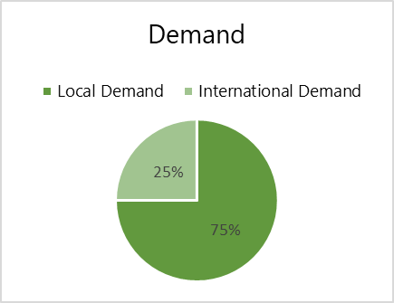
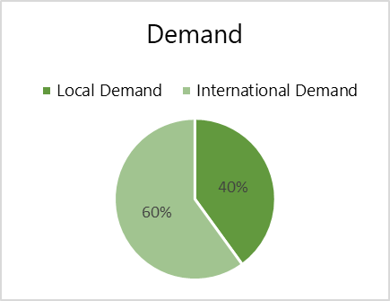
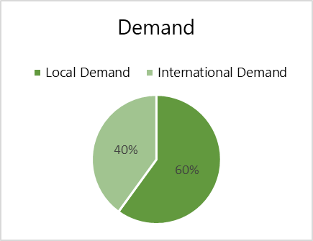
Brazil Demand and Exports
Acai
Demand
Brazil Nuts
Demand
Pirarucu
Demand
Key Export Markets: USA (28.3%), UAE (21.5%), Australia (10.3%)
Key Export Markets:
USA (24.4%), Peru (20.4%), Australia (10.1%)
Key Export Markets:
USA (35%), Europe: Germany-France (25%), China (20%)

Slide 22
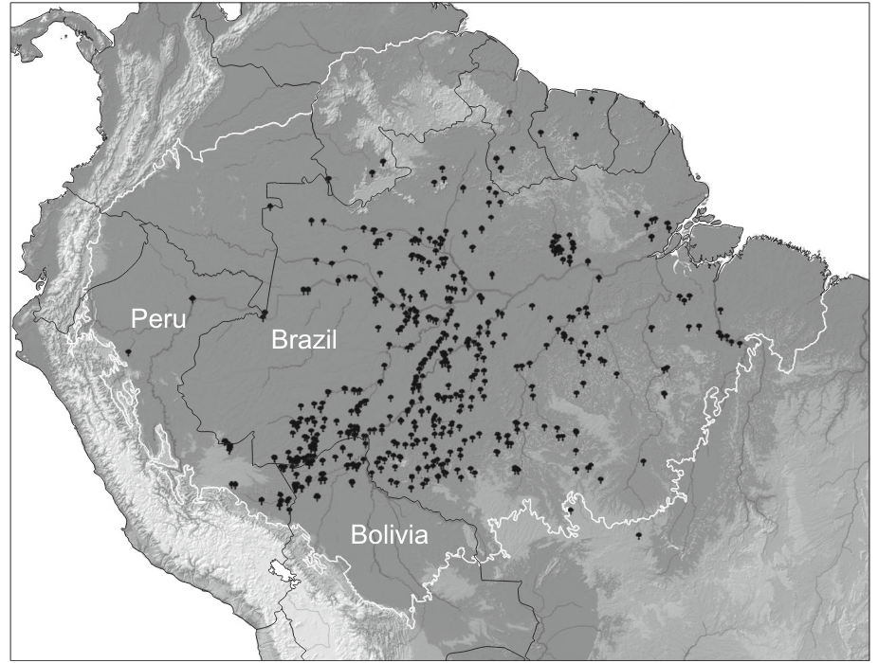
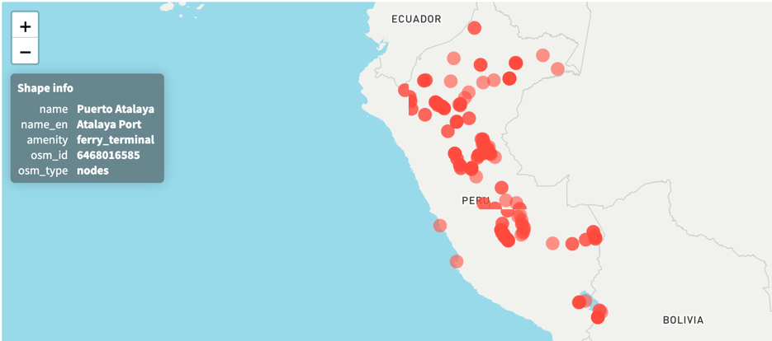
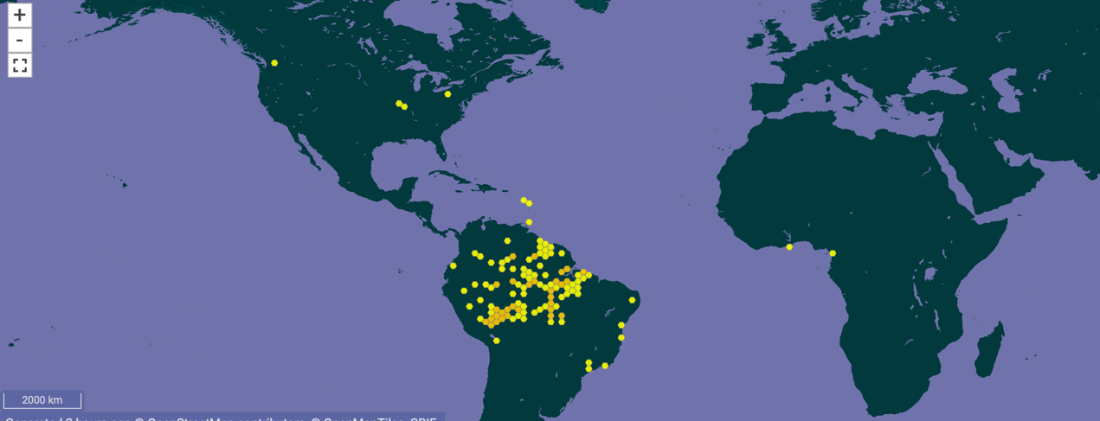
Data – Other Countries (Peru and Colombia)
Supply: distribution of Brazil nut trees across the Amazon River basin
Basic information (Peru): population density, waterways, roads, railways, airports, ports…
Production (Brazil nuts in Peru in total): 6194 tonnes (2016) ->5697 tonnes (2020)
Catalogue of Life Checklist, 2024
Ports in Peru, Humanitarian Data Exchange, 2024

Slide 23
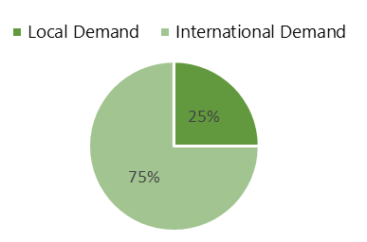
Peru Demand and Exports
Acai
Demand
Brazil Nuts
Demand
Pirarucu
Demand
Key Export Markets:
USA (35%), Canada (20.41%), Netherlands (6.34%)
Key Export Markets:
USA (34.9%), South Korea (16.6%), Finland (4.92%)
Key Export Markets:
USA, Germany, Netherlands

Slide 24
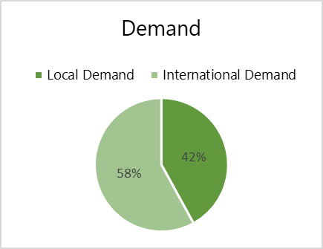
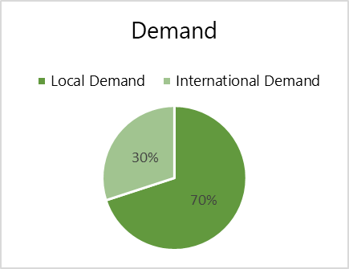
Colombia Demand and Exports
Acai
Demand
Brazil Nuts
Demand
Pirarucu
Demand
Key Export Markets:
United States, Germany, and Netherlands
Key Export Markets:
Aruba (39.1%), India (31.2%), UK (8.43%)
Key Export Markets:
USA, Germany, France

Slide 25
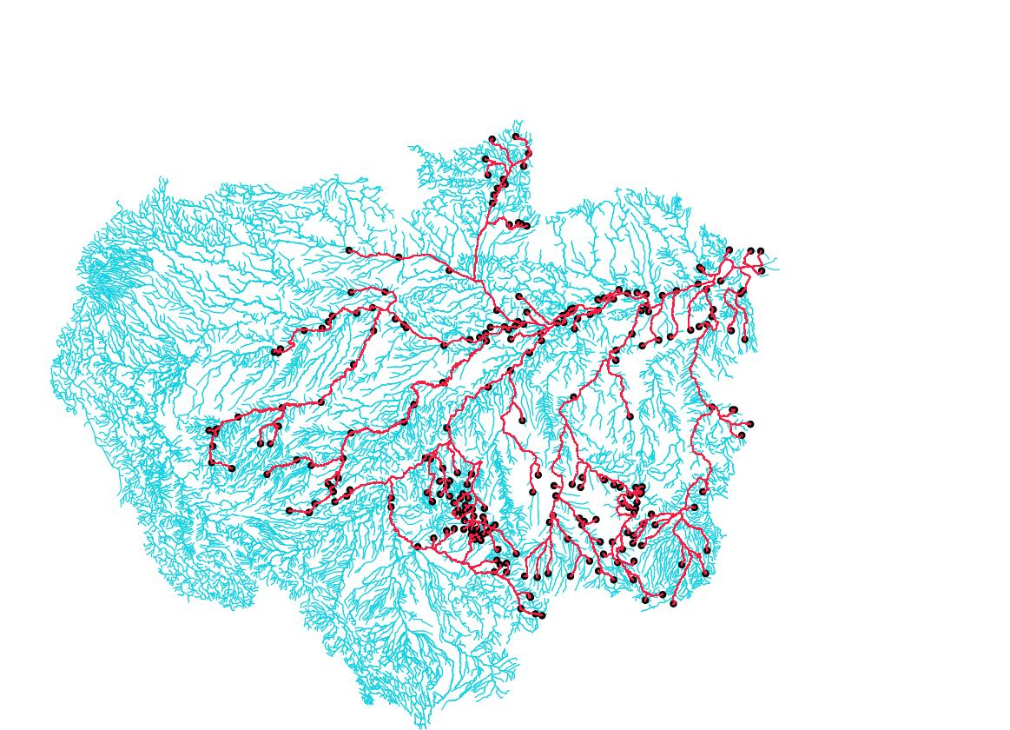
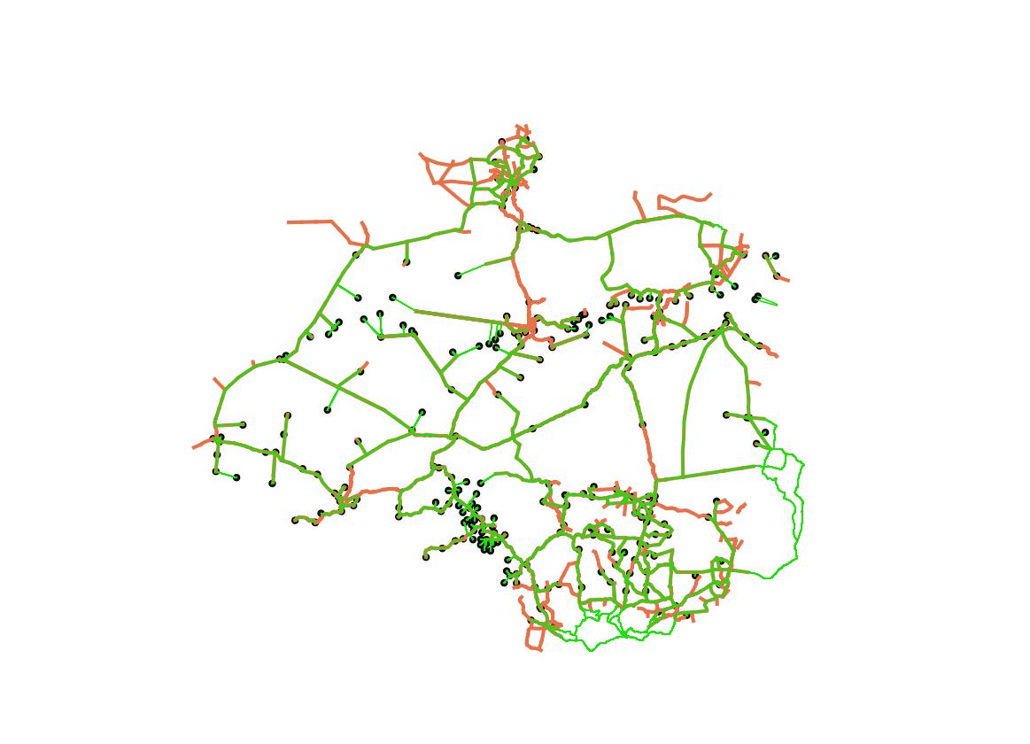
Data – Geographical Routing
Origin-Destination matrices and optimal route generation:
- Amazon Forest Waterway
- 2014 Highway
- Only for town in Amazon Forest Basin
Methodology: QGIS-QNEAT3
- Ellipsoids calculation (3D distance calculation)
- Optimal route by minimal distance travel along the route
- Cost (Distance) Calculation:
- Entry Cost (Origin town -->Route)
- Network Cost (Distance along the route)
- Exit Cost (Route --> Destination town)
- Total Cost (Sum of other costs)
- Example OD matrix (Waterway)
Waterway, Town, Existing Waterway, Shortest Path
Origin_id | Destination_id | Entry_cost(m) | Network_cost(m) | Exit_cost(m) | Total_cost(m)
Alto Paraíso | Buritis | 2491.460977 | 439496.1883 | 1752.481448 | 443740.1307
Alto Paraíso | Novo Horizonte do Oeste | 2491.460977 | 878368.8325 | 12796.63321 | 893656.9266
2014 Highway, Town, Existing Highway, Shortest Path
Notes:
In order to find the distance between town for warehouse distribution, OD matrices for each town is generated using QGIS – QNEAT3 plugin
The distance is based on the route of waterway or highway for a more accurate displacement taken for each trip
The distance is calculated using Ellipsoids projection which is 3D rather 2D map projection, which is more accurate for large area
The output also consider the distance taken to access and egress the route from each town: which could be weighted differently in the warehouse location model

Slide 26
Next milestones
Capacitated warehouse clustering (With existing local infrastructure)
Process Pirarucu production data
Airport & Port locations and routing
Literature review for strategy comparison (Deliverable 5)

Slide 27
Project Scope
- Scope: Brazilian Amazon
Assumptions: Use local markets and farms of a certain size as sources.
Modes: Waterways transport in forest area, Considered rail, road, and Air if only existed facility
Echelons considered: (Forest) --> Local Market/ Farms --> Warehouses --> Factory --> Final destination (Harbours, Airports)
Objective: Establish a centralized warehouse (or a group of warehouses) with modern facilities to Improving supply chain quality and forming a rational network.
Objective Setting and Information Gathering
Data Processing
Assumptions based on constraints
Modelling
Feasibility analysis of the result
Final Outcomes

Slide 28
Project Scope
 | Establishing Warehouse(s) | Find the optimal routes
Benefits | Improved Storage Condition Economies of Scale Standardized Logistics | Optimized Routes Dynamic Adaptability Scalability
Challenges | Location Selection Large Initial Investment Regulatory and Environmental Concerns | Need to balance multiple objectives. Technological Infrastructure Coordination Complexity (multiple stakeholders)
Suggestions | Considering the unique challenges and opportunities in the Amazon region, a combined approach integrating a centralized warehouse with routes optimization may provide the most comprehensive solution.

Slide 29
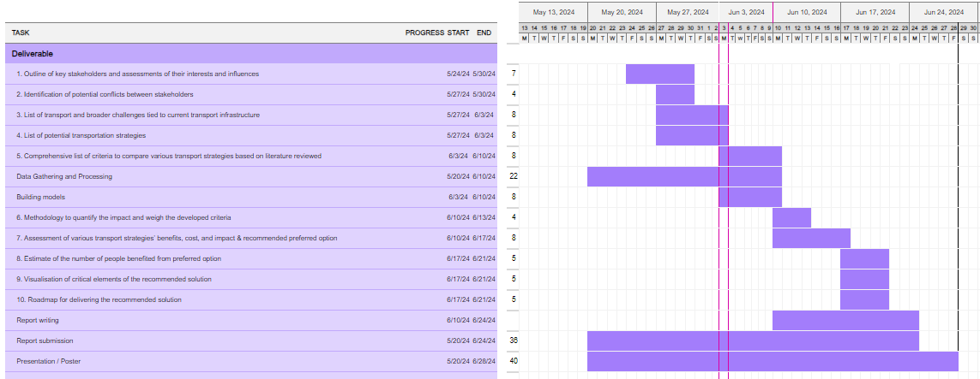
Gantt chart

